Slide 1
Static vs. Interactive – The Exploration Shift
The Limitation of Static: Standard charts are "read-only." If a manager wants to see the exact value of a specific data point, they have to ask the developer.
The Solution: Plotly: High-level interactivity. Users can hover for tooltips, zoom into specific timeframes, and click legends to filter categories.
Cufflinks: A bridge library that allows us to call .iplot() directly on a Pandas DataFrame, making interactive visualization as easy as a single line of code.

Slide 2
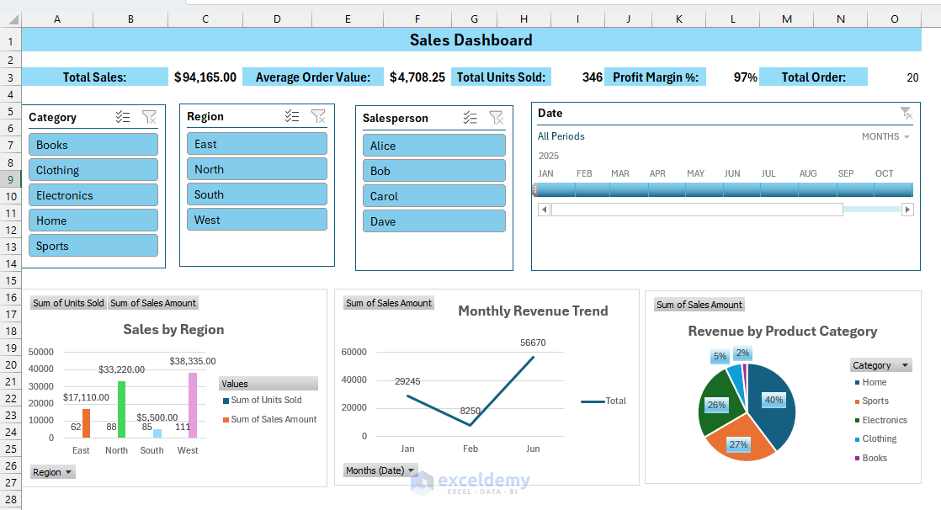
Streamlit – The 10-Minute Dashboard
The Evolution: Traditionally, a data scientist needed to learn HTML, CSS, and Javascript (or Flask/Django) to share a dashboard.
Streamlit's Innovation: A framework that turns a Python script into a beautiful, shareable web app using only Python.
Immediate Value: It allows teams to prototype "Decision Support Systems" in hours rather than weeks, which is a highly sought-after skill in the 2026 job market.

Slide 3
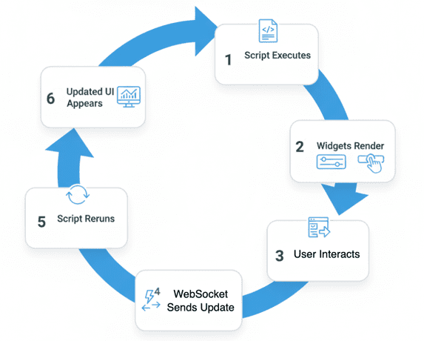
Widgets: Empowering the Stakeholder
The Paradigm: We stop writing hard-coded filters (e.g., df[df['Region'] == 'Peshawar']) and start writing dynamic inputs.
Control Elements:
Sliders: For selecting date ranges or sensitivity levels.
Dropdowns: For switching between different metrics (e.g., GDP vs. Population).
Buttons: For triggering specific simulations or data refreshes.
Goal: Creating a "Data Playground" where managers can find their own answers.

